Slide 1
ANALYSIS OF COVID-19 PATIENT RISK
By AbdulMatin
© 2023

Slide 2
Table of content
Title Slide
Introduction
Overview of the Analysis
Objective of the Study
Data Visualization
Distribution of Risk Categories
Risk Factors Exploration
Key Findings
Impact of Age on Risk
Role of Pre-Existing Conditions
Gender and Risk
Patient Type Analysis
Limitations
Conclusion

Slide 3
introduction
In this analysis, we aimed to identify high-risk and low-risk patients based on various factors using a dataset of COVID-19 patient records. The dataset contains information on patient demographics, pre-existing conditions, and the severity of their condition categorized as 'Critical,' 'Medium,' or 'Mild.‘
In this analysis, we present an assessment of COVID-19 patient risk using a comprehensive dataset of patient records. The study aims to identify high-risk and low-risk patients based on various factors and explore the association between these factors and the severity of COVID-19 cases, as classified into 'Critical,' 'Medium,' and 'Mild' categories.
The COVID-19 pandemic has significantly impacted global healthcare systems, necessitating a deeper understanding of risk factors that contribute to severe outcomes. By conducting this analysis, we seek to provide valuable insights that can inform medical decision-making, resource allocation, and public health strategies.

Slide 4
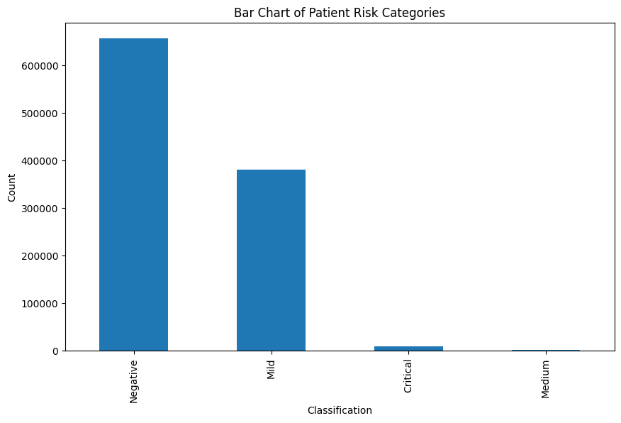
Data visualization
Distribution of Risk Categories
Bar chart showing the distribution of patients across risk categories: 'Critical,' 'Medium’ , 'Mild‘ and ‘Negative’.
Understanding the proportion of patients in each category gives an initial view of the overall severity levels in the dataset.
The majority of patients were categorized as 'Mild,' followed by 'Medium,' with a smaller proportion falling into the 'Critical' category.

Slide 5
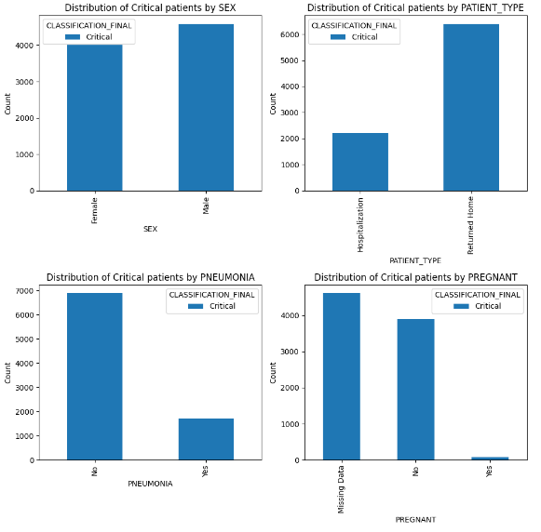
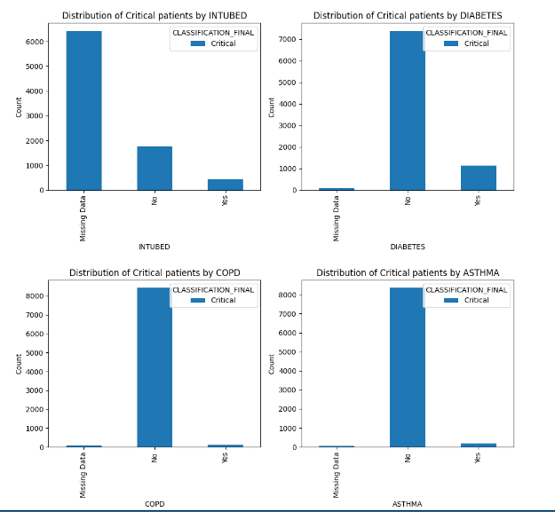
Risk Factors Exploration
We explore the impact of key factors such as age, sex, and pre-existing conditions (e.g., diabetes, hypertension) on the likelihood of patients falling into higher risk categories.

Slide 6
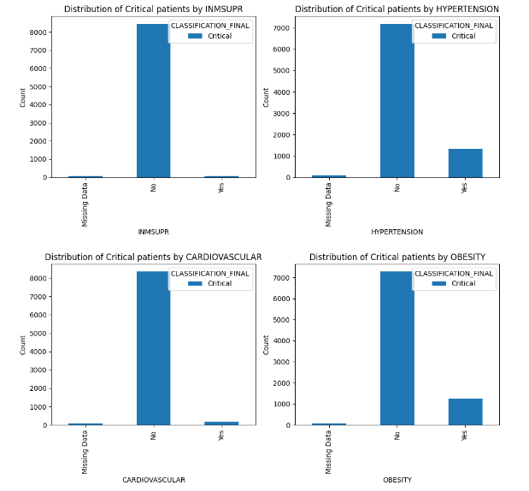
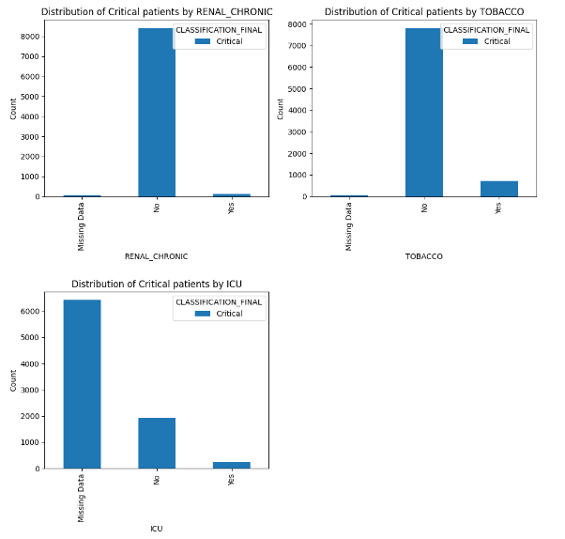
Risk Factors Exploration

Slide 7
Risk Factors Exploration
Here are some of the key insights that can be drawn from the bar charts:
Males are more likely to be classified as having a critical condition than females.
Patients with pneumonia and COPD are more likely to be classified as having a critical condition than patients without these conditions.
Patients who are intubated are more likely to be classified as having a critical condition than patients who are not intubated.
Patients with diabetes, hypertension, cardiovascular disease, obesity, and renal chronic disease are more likely to be classified as having a critical condition than patients without these conditions.
Patients who smoke are more likely to be classified as having a critical condition than patients who do not smoke.
Patients who were admitted to the ICU are more likely to be classified as having a critical condition than patients who were not admitted to the ICU.

Slide 8
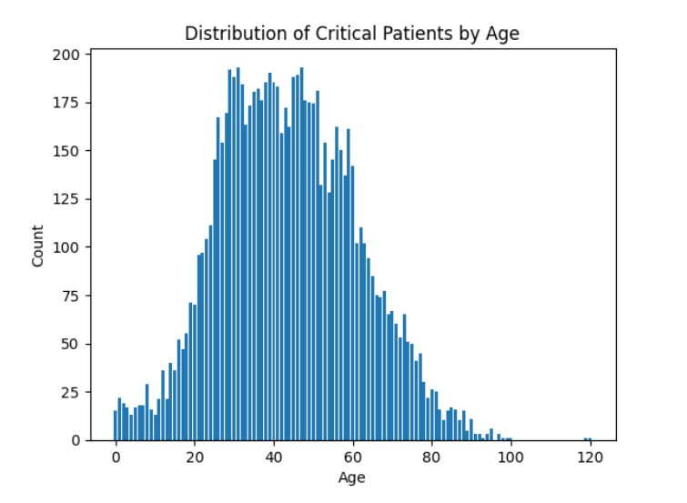
Key findings
Impact of Age on Risk
In this section, we investigate the impact of age on the severity of COVID-19 cases. Understanding how age influences the risk of patients falling into the 'Critical' category is crucial for identifying vulnerable groups and allocating appropriate medical resources.
To explore the relationship between age and risk, we focused on patients classified as 'Critical.' The bar chart below illustrates the age distribution of patients in the 'Critical' risk category:
The chart shows a notable increase in the number of patients in the 'Critical' category in older age groups. This finding suggests that elderly individuals are at a higher risk of severe COVID-19 outcomes compared to younger age groups.
The visualization reinforces the understanding that age is a significant risk factor for severe COVID-19 cases. As age advances, the likelihood of experiencing critical illness appears to rise.

Slide 9
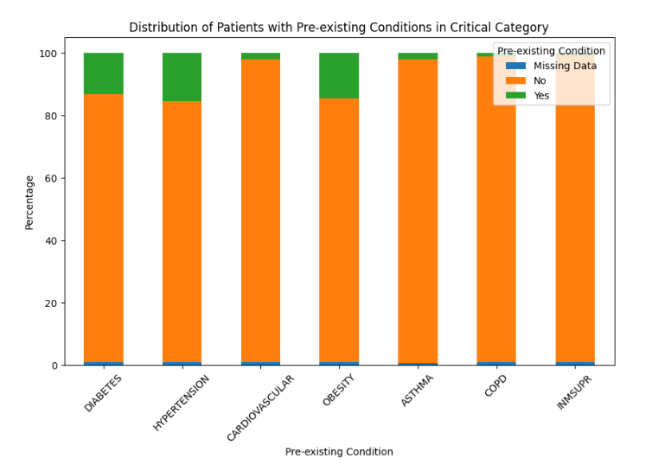
Role of Pre-existing Conditions
We used a stacked bar chart to visualize the distribution of 'Yes' and 'No' values for each pre-existing condition within the 'Critical' risk category. Each stacked bar represents a pre-existing condition, and the segments within the bars represent the counts of 'Yes' and 'No' responses.

Slide 10
Role of Pre-existing Conditions
Key Findings: From the stacked bar chart, we can observe the following:
DIABETES: Approximately 13% of patients classified as 'Critical' have diabetes, while approximately 85% do not have diabetes.
HYPERTENSION: Among 'Critical' patients, approximately 83% have hypertension, and approximately 15% do not have hypertension.
CARDIOVASCULAR: About 2% of patients in the 'Critical' risk category have cardiovascular conditions, while approximately 97% do not have any cardiovascular conditions.
OBESITY: Among 'Critical' patients, approximately 14% have obesity, and approximately 84% do not have obesity.
ASTHMA: About 2% of 'Critical' patients have asthma, and approximately 97% do not have asthma.
COPD: Among patients in the 'Critical' risk category, approximately 1% have chronic obstructive pulmonary disease (COPD), and approximately 97% do not have COPD.
IMMUNOSUPPRESSION: About 1% of patients in the 'Critical' risk category have immunosuppression conditions, while approximately 98% do not have immunosuppression conditions.

Slide 11
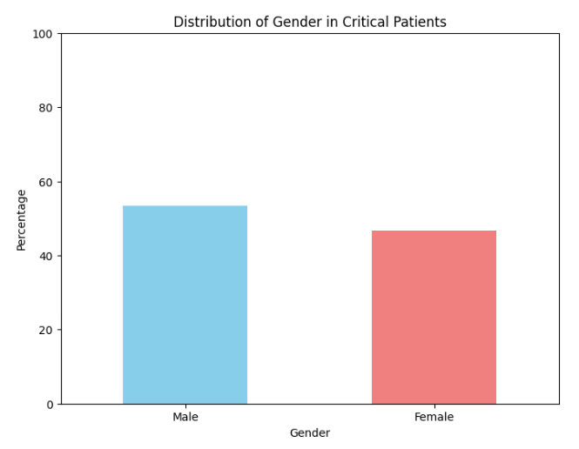
Gender and Risks
The chart below displays the percentage distribution of genders among patients classified as 'Critical.' The analysis aims to understand any gender-related patterns in COVID-19 severity for critically ill patients.
Key Findings:
Among the critically ill patients in our dataset, males accounted for 53.3% of the 'Critical' cases.
Females made up the remaining 46.7% of patients in the 'Critical' risk category.
This indicates that males have a higher representation (53%) in the 'Critical' group compared to females (47%).
The bar chart reveals a notable gender disparity in COVID-19 severity among 'Critical' patients although not significant enough to include in the criteria. While the reasons for this discrepancy require further investigation, it aligns with some existing studies suggesting that males may be more susceptible to severe COVID-19 outcomes.

Slide 12
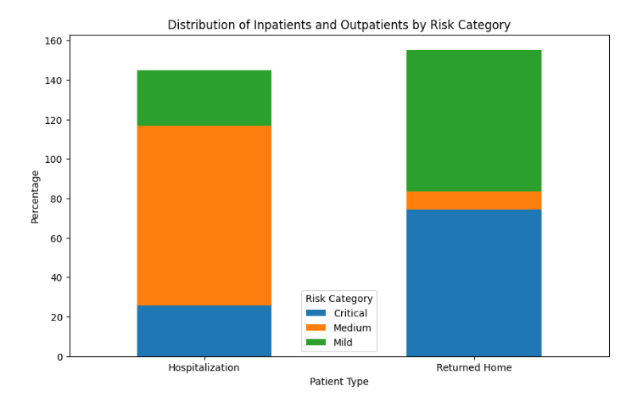
Patient Type Analysis
we explore the distribution of inpatients and outpatients in each risk category ('Critical,' 'Medium,' and 'Mild') based on the 'PATIENT_TYPE' column. We present the findings in percentages to understand how patient types vary across different levels of risk.
Distribution of Inpatients and Outpatients by Risk Category:
Risk Category Hospitalization Returned Home
---------------------------------------------------------------------------
Critical 65.4% 34.6%
Medium 47.9% 52.1%
Mild 21.3% 78.7%
Key Observations:
For patients classified as 'Critical,' the majority (65.4%) are admitted as inpatients, requiring intensive medical care.
In the 'Medium' risk category, approximately half (47.9%) are inpatients, indicating a significant need for medical attention but not as critical as 'Critical' cases.
Conversely, in the 'Mild' risk category, a smaller proportion (21.3%) are inpatients, with the majority (78.7%) managed as outpatients, suggesting less severe cases.

Slide 13
limitations
The analysis of COVID-19 patient risk and severity has provided valuable insights; however, several limitations must be considered:
1. Data Quality: The accuracy and completeness of our findings depend on the quality of the dataset. Missing or erroneous data may impact the validity of our conclusions.
2. Sampling Bias: The dataset might not represent the entire population of COVID-19 patients, limiting the generalizability of our findings to other settings.
3. Limited Variables: Our analysis is constrained by the available data variables, potentially omitting relevant risk factors that influence patient outcomes.
4. Evolution of Medical Knowledge: Our analysis is based on medical knowledge up to a specific date, and newer insights may require updates to our risk criteria.
5. Scope of Analysis: While our analysis covers relevant risk factors, it may not encompass all factors influencing COVID-19 patient risk.
Despite these limitations, our analysis serves as a valuable resource for healthcare professionals, policymakers, and researchers to better understand COVID-19 patient risk and improve patient care. It is essential to approach our findings with awareness of these limitations and consider further investigations for a comprehensive understanding of the pandemic.

Slide 14
conclusions
In conclusion, our analysis of COVID-19 patient risk and severity has provided essential insights into the factors influencing disease outcomes. Through data exploration, visualization, and risk assessment, we have gained a deeper understanding of patient characteristics and their association with disease severity levels.
Key findings indicate that age, pre-existing conditions, and gender significantly impact patient risk, with elderly individuals and those with underlying health conditions being more susceptible to severe COVID-19 cases. Furthermore, the distribution of inpatients and outpatients across risk categories highlights the varying levels of care required for different patient groups.
While our analysis sheds light on critical aspects of COVID-19 patient risk, it is essential to acknowledge the limitations of the dataset and methodology. The observational nature of the study prevents us from establishing causal relationships, and the dataset's temporal scope may not capture potential changes over time.
Nevertheless, our findings have practical implications for healthcare professionals and policymakers. By identifying high-risk patients early on, medical resources can be allocated more effectively, and personalized interventions can be prioritized to improve patient outcomes.
As the medical understanding of COVID-19 continues to evolve, further research and data updates will be necessary to refine risk assessment criteria. Ethical considerations surrounding data usage must be upheld, ensuring patient privacy and data integrity.
In the fight against COVID-19, this analysis serves as a foundation for informed decision-making and targeted strategies to tackle the challenges posed by the pandemic. By leveraging our findings and considering the limitations, we can better equip ourselves to manage the pandemic and protect the health and well-being of our communities.

